Slide 1
CHAPTER II Algorithm Analysis
Data Structures and Algorithm Analysis in Java 3rd Edition by Mark Allen Weiss

Slide 2
What is An Algorithm?
Step-by-step instructions to solve a specific problem
There can give multiple algorithms to solve a problem
How do you determine which one is best?
Time
Space
Asymptotic Notation

Slide 3
Time Complexity
Analysis is based on the amount of work done by the algorithm
Time complexity expresses the relationship between the size of the input and the run time for the algorithm
Usually expressed as a proportionality, rather than an exact function

Slide 4
Time Complexity
Simplified analysis can be based on:
Number of arithmetic operations performed
Number of comparisons made
Number of times through a critical loop
Number of array elements accessed
etc

Slide 5
Big-Oh and Other Notations in Algorithm Analysis
Classifying Functions by Their Asymptotic Growth
Theta, Little oh, Little omega
Big Oh, Big Omega
Rules to manipulate Big-Oh expressions
Typical Growth Rates

Slide 6
Classifying Functions by Their Asymptotic Growth
Asymptotic growth : The growth rate of a function
Given a particular differentiable function f(n), all other differentiable functions fall into three classes:
.growing with the same rate
.growing faster
.growing slower

Slide 7
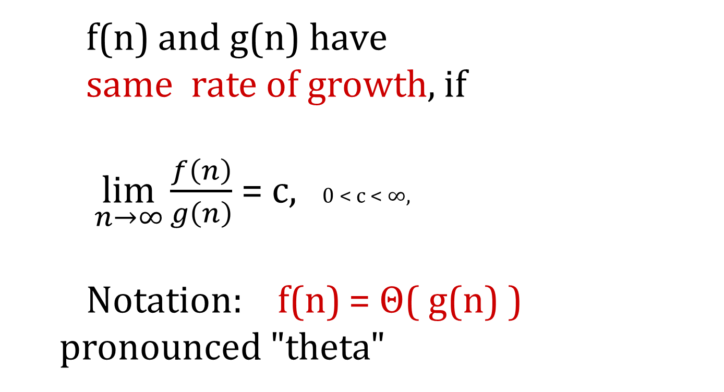
Theta
f(n) and g(n) have
same rate of growth, if
$\lim_{n→∞}\frac{f\left(n\right)}{g\left(n\right)}$ = c, 0 < c < ∞,
Notation: f(n) = Θ( g(n) )
pronounced "theta"

Slide 8
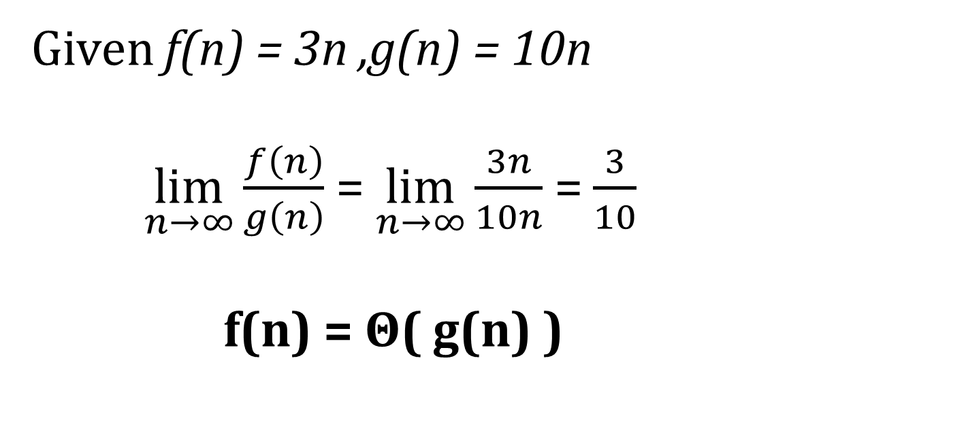
Theta
Given f(n) = 3n ,g(n) = 10n
$\lim_{n→∞}\frac{f\left(n\right)}{g\left(n\right)}$ = $\lim_{n→∞}\frac{3n}{10n}$ = $\frac{3}{10}$
f(n) = Θ( g(n) )

Slide 9
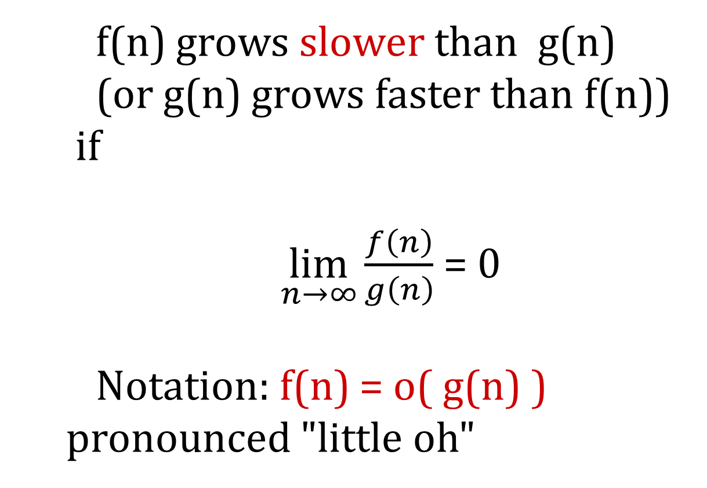
Little oh
f(n) grows slower than g(n)
(or g(n) grows faster than f(n))
if
$\lim_{n→∞}\frac{f\left(n\right)}{g\left(n\right)}$= 0
Notation: f(n) = o( g(n) )
pronounced "little oh"

Slide 10
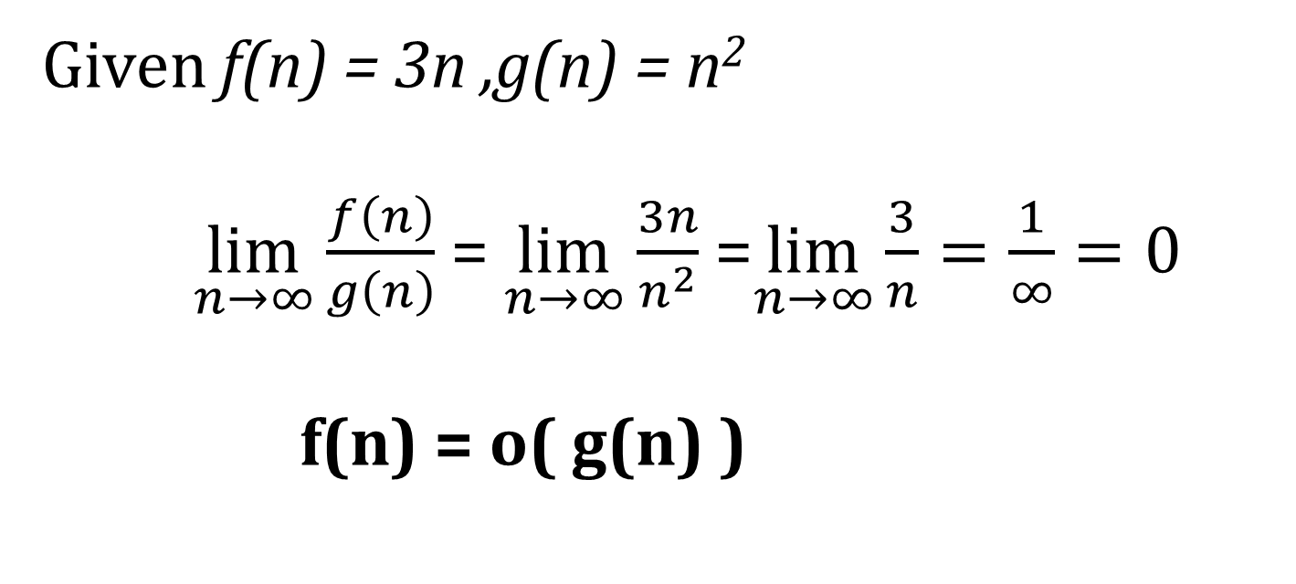
Little oh
Given f(n) = 3n ,g(n) = n²
$\lim_{n→∞}\frac{f\left(n\right)}{g\left(n\right)}$ = $\lim_{n→∞}\frac{3n}{n^{2}}$ =$\lim_{n→∞}\frac{3}{n}=\frac{1}{∞}=0$
f(n) = o( g(n) )

Slide 11
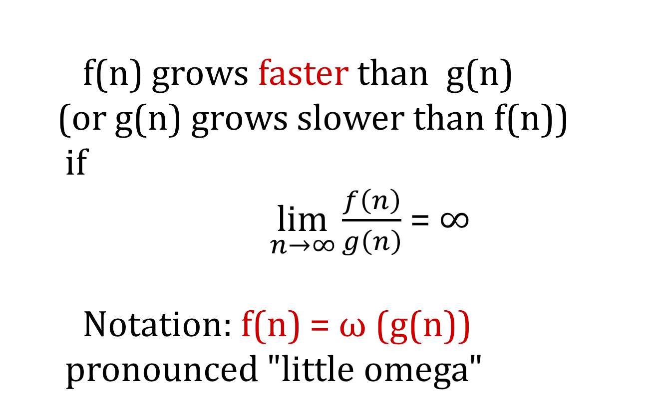
Little omega
f(n) grows faster than g(n)
(or g(n) grows slower than f(n))
if
$\lim_{n→∞}\frac{f\left(n\right)}{g\left(n\right)}$= ∞
Notation: f(n) = ω (g(n))
pronounced "little omega"

Slide 12
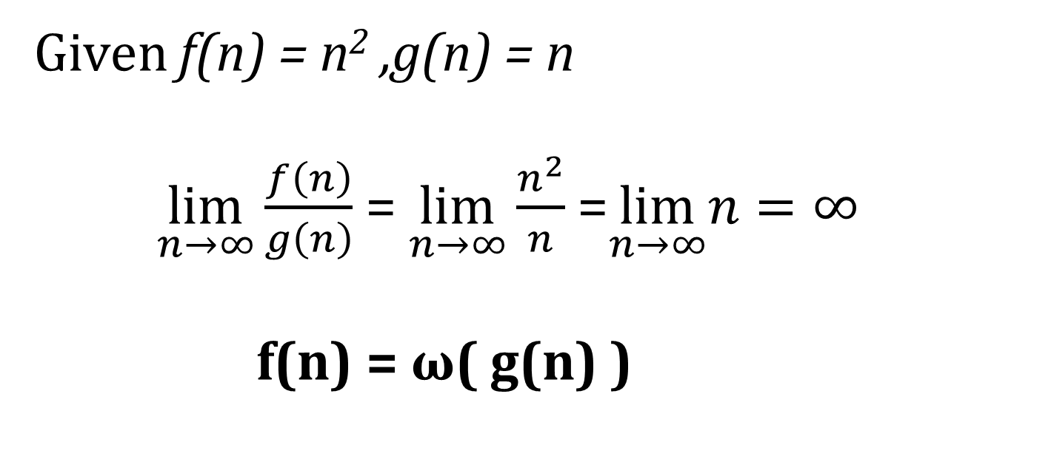
Little omega
Given f(n) = n² ,g(n) = n
$\lim_{n→∞}\frac{f\left(n\right)}{g\left(n\right)}$ = $\lim_{n→∞}\frac{n^{2}}{n}$ =$\lim_{n→∞}n=∞$
f(n) = ω( g(n) )

Slide 13
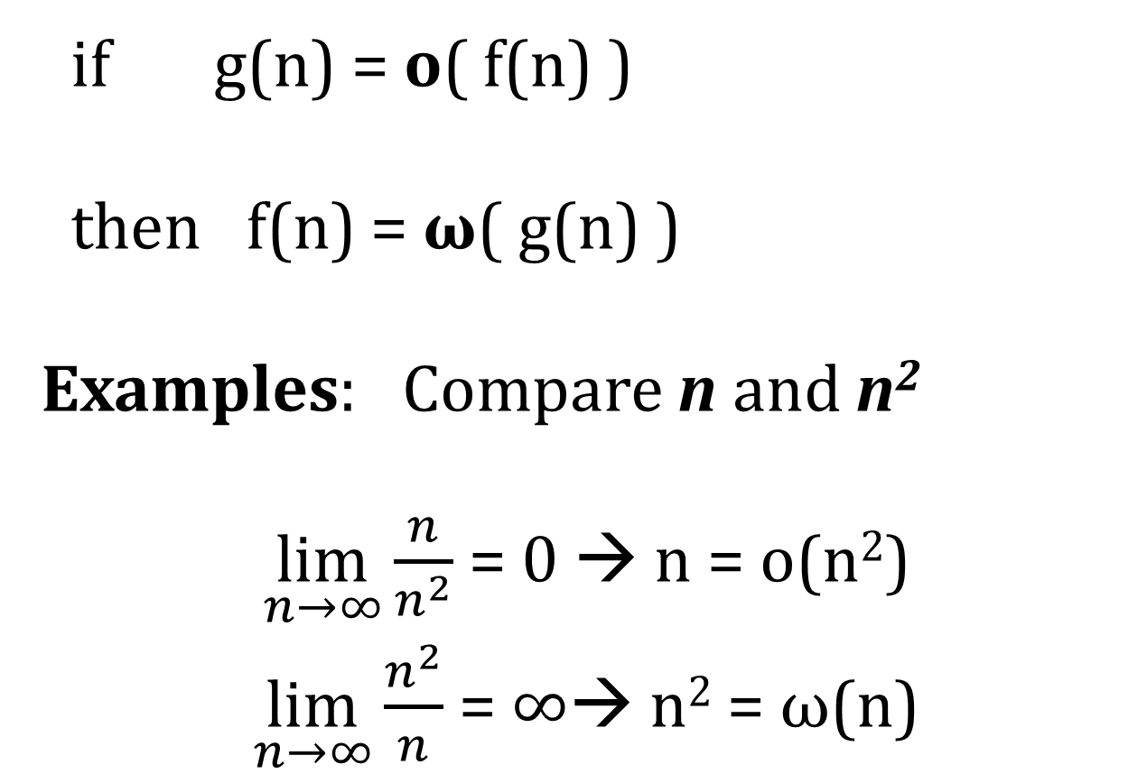
Little omega and Little oh
if g(n) = o( f(n) )
then f(n) = ω( g(n) )
Examples: Compare n and n²
$\lim_{n→∞}\frac{n}{n^{2}}$= 0 → n = o(n²)
$\lim_{n→∞}\frac{n^{2}}{n}$= ∞→ n² = ω(n)

Slide 14
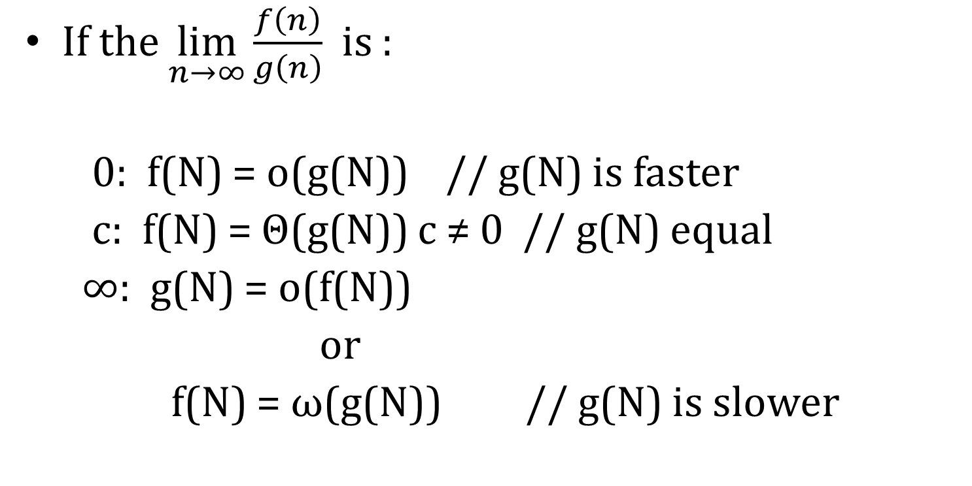
Summary of Relative Growth Rates
If the $\lim_{n→∞}\frac{f\left(n\right)}{g\left(n\right)}$ is :
0: f(N) = o(g(N)) // g(N) is faster
c: f(N) = Θ(g(N)) c ≠ 0 // g(N) equal
∞: g(N) = o(f(N))
or
f(N) = ω(g(N)) // g(N) is slower

Slide 15
Math Background
O Big O. Upper bound (possibly equal).
Θ Theta. Growth rates are equal.
Ω Omega. Lower bound (possibly equal).
o Little o. Upper bound (not equal).
ω Little Omega. Lower bound(not equal).

Slide 16
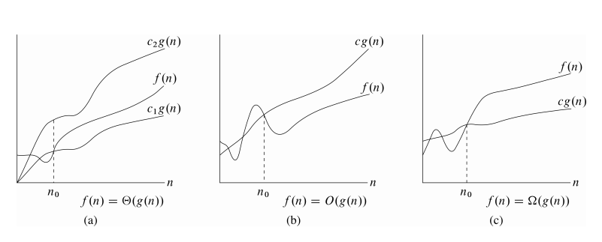
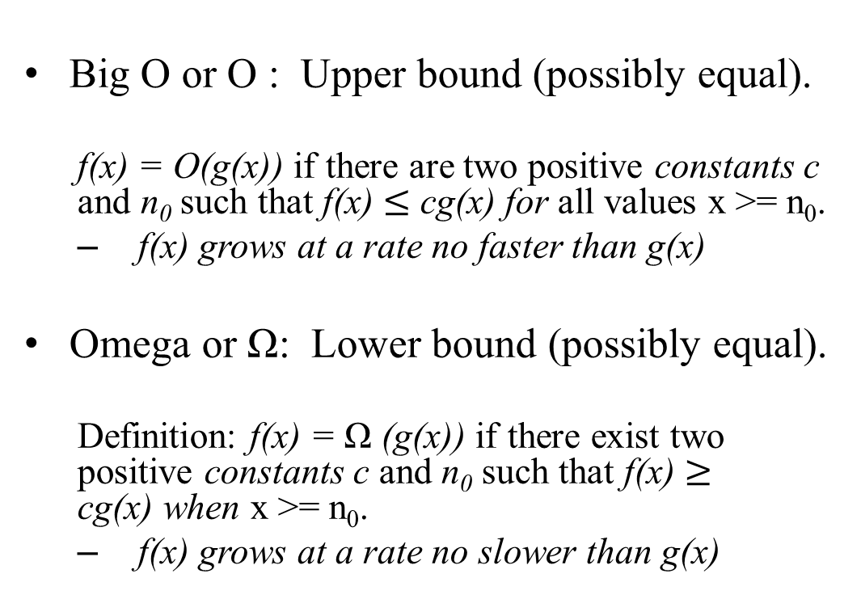
Mathematical Background
Big O or O : Upper bound (possibly equal).
f(x) = O(g(x)) if there are two positive constants c and n₀ such that f(x) $≤$ cg(x) for all values x >= n₀.
f(x) grows at a rate no faster than g(x)
Omega or Ω: Lower bound (possibly equal).
Definition: f(x) = Ω (g(x)) if there exist two positive constants c and n₀ such that f(x) $≥$ cg(x) when x >= n₀.
f(x) grows at a rate no slower than g(x)

Slide 17
Mathematical Background
Theta or Θ Growth rates are equal.
Definition: f(x) = Θ (g(x)) if there exists three constants c1>0,c2>0, n₀ ≥0 such that
c₁g(x) ≤ f(x) ≤ c₂g(x) for x >= n₀.
Little o or o. Upper bound (not equal).
Definition: f(x) = o(g(x)) if f(x) = O(g(x)) and
f(x) ≠ Θ(g(x))
g(x) is faster than f(x) growth
Little ω . Lower bound (not equal)
Mirror image of Little o.

Slide 18
Mathematical Background
cs.utsa.edu/~bylander/

Slide 19
Theta: Relation of Equivalence Algorithms with Same Complexity
R: "having the same rate of growth": relation of equivalence,
gives a partition over the set of all differentiable functions - classes of equivalence.
Functions in one and the same class are equivalent with respect to their growth.
Two algorithms have same complexity, if the functions representing the number of operations have same rate of growth.
Among all functions with same rate of growth we choose the simplest one to represent the complexity.

Slide 20
Example with growth rate
g(n) = 8 N⁴ can be classified as
either O(N⁴ ) or Ω(N⁴) or Θ(N⁴).
Θ(N⁴) is the “tightest” description.
In algorithms analysis, typically we are concerned with how bad an algorithm may perform, which implies knowing an upper bound, so normally we use O rather than Θ.

Slide 21
Examples
Compare n and (n+1)/2
lim( n / ((n+1)/2 )) = 2,
same rate of growth
(n+1)/2 = Θ(n)
- rate of growth of a linear function

Slide 22
Examples
Compare n² and n²+ 6n
lim( n² / (n²+ 6n ) )= 1
same rate of growth.
n²+6n = Θ(n²)
rate of growth of a quadratic function

Slide 23
Examples
Compare log n and log n²
lim( log n / log n² ) = 1/2
same rate of growth.
log n² = Θ(log n)
logarithmic rate of growth

Slide 24
Examples
Θ(n³): n³
5n³+ 4n
105n³+ 4n² + 6n
Θ(n²): n²
5n²+ 4n + 6
n² + 5
Θ(log n): log n
log n²
log (n + n³)

Slide 25
Comparing Functions
same rate of growth: g(n) = Θ(f(n))
different rate of growth:
either g(n) = o (f(n))
g(n) grows slower than f(n),
and hence f(n) = ω(g(n))
or g(n) = ω (f(n))
g(n) grows faster than f(n),
and hence f(n) = o(g(n))

Slide 26
The Big-Oh Notation
f(n) = O(g(n))
if f(n) grows with
same rate or slower than g(n).
f(n) = Θ(g(n)) or
f(n) = o(g(n))

Slide 27
Example
n+5 = Θ(n) = O(n) = O(n²)
= O(n³) = O(n⁵)
the closest estimation: n+5 = Θ(n)
the general practice is to use
the Big-Oh notation:
n+5 = O(n)

Slide 28
The Big-Omega Notation
The inverse of Big-Oh O is Ω
If g(n) = O(f(n)),
then f(n) = Ω (g(n))
f(n) grows faster or with the same rate as g(n): f(n) = Ω (g(n))

Slide 29
Rules to manipulate Big-Oh expressions
Rule 1:
a. If T1 (N) = O(f(N)) and T2(N) = O(g(N))
then
T1(N) + T2(N) = max( O( f (N) ), O( g(N) ) )
Eg: n² +10 = O(n²)
50n³ +45n⁵+60n+100 = O(n⁵)

Slide 30
Rules to manipulate Big-Oh expressions
b. If T1(N) = O( f(N) ) and T2(N) = O( g(N) )
then
T1(N) * T2(N) = O( f(N)* g(N) )
Eg: 10n² * 10n² = O(n⁵)

Slide 31
Rules to manipulate Big-Oh expressions
Rule 2:
If T(N) is a polynomial of degree k,
then
T(N) = Θ( N^{k} )
Rule 3:
log ^{k} N = O(N) for any constant k.

Slide 32
Examples
n² + n = O(n²)
we disregard any lower-order term
nlog(n) = O(nlog(n))
n² + nlog(n) = O(n²)

Slide 33
Typical Growth Rates
C constant, we write O(1)
logN logarithmic
log²N log-squared
N linear
NlogN
N² quadratic
N³ cubic
2^{N} exponential
N! factorial

Slide 34
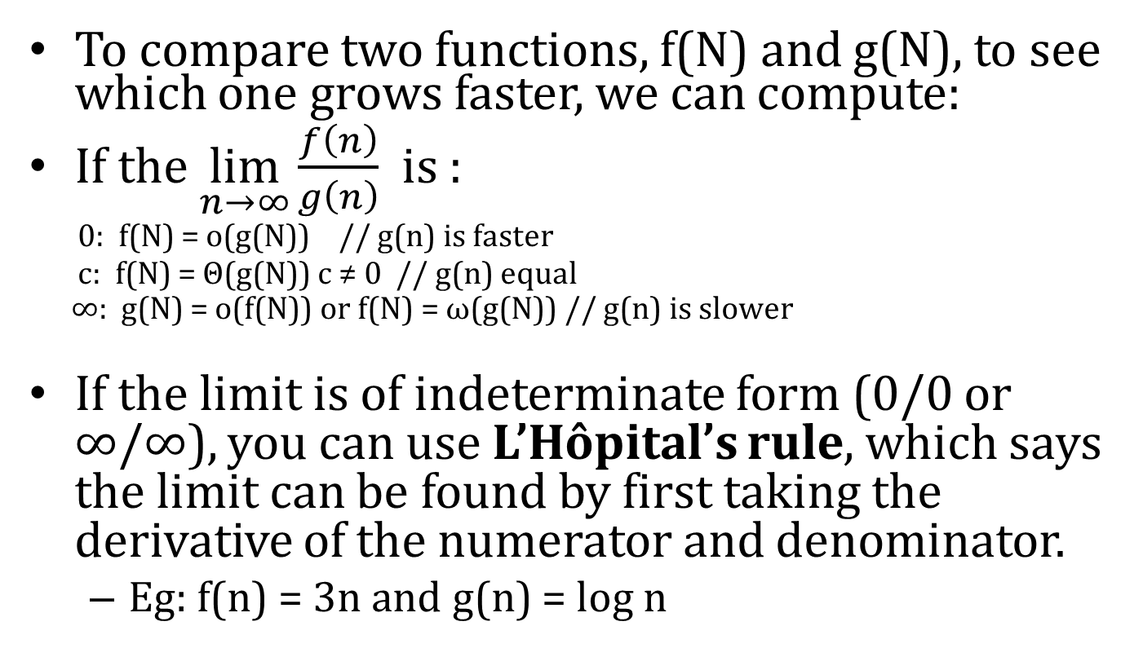
Summary of Relative Growth Rates
To compare two functions, f(N) and g(N), to see which one grows faster, we can compute:
If the $\lim_{n→∞}\frac{f\left(n\right)}{g\left(n\right)}$ is :
0: f(N) = o(g(N)) // g(n) is faster
c: f(N) = Θ(g(N)) c ≠ 0 // g(n) equal
∞: g(N) = o(f(N)) or f(N) = ω(g(N)) // g(n) is slower
If the limit is of indeterminate form (0/0 or ∞/∞), you can use L’Hôpital’s rule, which says the limit can be found by first taking the derivative of the numerator and denominator.
Eg: f(n) = 3n and g(n) = log n

Slide 35
Problems
N² = O(N²)
2N = O(N²)
N = O(N²)
N² = O(N)
2N = O(N)
N = O(N)
true
true
true
false
true
true

Slide 36
Problems
true
false
false
false
true
true
N² = Θ (N²)
2N = Θ (N²)
N = Θ (N²)
N² = Θ (N)
2N = Θ (N)
N = Θ (N)

Slide 37
Style
Lower-order terms are ignored: 3N³ + N² + N + 6 is O(N³)
Why? Because the 3N³ causes the function to grow at a cubic rate. The N² , N and 5 contribute some but the growth rate is quadratic.

Slide 38
Model
To analyze algorithms, we use a conceptual model of a computer.
In this model, all operations take one unit of time, and model has infinite memory.
With this the analysis is focused on the algorithm, independent of any machine.
Of course, other factors may be important in an actual implementation such reading data, which is bottleneck.

Slide 39
What to Analyze
The most important thing to analyze is running time.
Algorithm
Size of the input
Two Functions can be calculated on an algorithm on input of size N:
T_{avg}(N)
T_{worst}(N)
Typically we analyze worst-case, Big Oh, performance since it bound for all possible inputs.
Best-case is less useful since it probably is rare
Average-case is much more difficult to analyze since it may be hard to define what data would be considered average.

Slide 40
What to Analyze
We use Java code in the examples, but the analysis really should be language-independent.
Notice that for small inputs, the difference between algorithms may not matter.
Also, in an actual setting, the time to read the input may be the bottleneck.

Slide 41
Big-O Analysis in General
Assume that a computer executes a million instructions a second. This chart summarizes the amount of time required to execute f(n) instructions on this machine for various values of n.
f(n) | n=10³ | n=10⁵ | n=10⁶
log₂(n) | 10⁻⁵ sec | 1.7 * 10⁻⁵ sec | 2 * 10⁻⁵ sec
n | 10⁻³ sec | 0.1 sec | 1 sec
n*log₂(n) | 0.01 sec | 1.7 sec | 20 sec
n² | 1 sec | 3 hr | 12 days
n³ | 17 min | 32 yr | 317 centuries
2^{n} | 10²⁸⁵ centuries | 10¹⁰⁰⁰⁰ years | 10¹⁰⁰⁰⁰⁰ years

Slide 42
Running Time Calculation
Algorithmic ideas and run time calculation will provide insights in to designing efficient algorithms
Running time analysis can be done by calculating Big Oh running time.
Ignore leading constants
Ignore low-order terms
Big Oh guarantees that the program will terminate within a certain time period as it is upper bound.

Slide 43
Example
Sample Program to calculate
public static int sum( int n) {
int partialSum;
partialSum = 0;
for(int i =1; i <=n ; i++)
partialSum += i * i * i ;
return partialSum;
}
1
2
3
4
//1 unit
// 1 + (n+1) + n
// 4 units * n
//1 unit
the result is O(n) : 1 + (2n+2) + 4n + 1 = 6n+4

Slide 44
General Rules
Rule 1 : for loops:
Rule 2: Nested loops
Rule 3: Consecutive Statements
Rule 4- if/else

Slide 45
Rule 1: for loops
Running time of a for loop =
running time of statements inside the loop
*
number of iterations

Slide 46
Rule 2: Nested Loops
Analyze inside out
Running time of statements inside times the product of loop sizes.
Example
for(i=0; i < n ; i++)
for(j=0; j<n ; j++)
k++;
The program fragment is O(N²)

Slide 47
Rule 2
With independent nested loops: The number of iterations of the inner loop is independent of the number of iterations of the outer loop
Example:
Outer loop executes n/2 times. For each of those times, inner loop executes n² times, so the body of the inner loop is executed (n/2)*n² = n³/2 times. The algorithm is O(n³) .
int x = 0;
for ( int j = 1; j <= n/2; j++ )
for ( int k = 1; k <= n*n; k++ )
x = x + j + k;

Slide 48
Rule 2
With dependent nested loops: Number of iterations of the inner loop depends on a value from the outer loop
Example:
When j is 1, inner loop executes 3 times; when j is 2, inner loop executes 3*2 times; … when j is n, inner loop executes 3*n times. In all the inner loop executes 3+6+9+…+3n = 3(1+2+3+…+n) = 3n²/2 + 3n/2 times. The algorithm is O(n²).
int x = 0;
for ( int j = 1; j <= n; j++ )
for ( int k = 1; k < 3*j; k++ )
x = x + j;

Slide 49
Rule 3: Consecutive Statements
Add them, which means take the maximum
for(i=0; i < n; i++)
a[i] = 0;
for(i=0; i<n; i++)
for(j=0; j <n; j++)
a[i] += a[j] +i +j;
O(N) work followed by O(N²) work, so use the maximum

Slide 50
O(N) Calculation
Let T1(N) and T2(N) be the number of operations necessary to run two program segments respectively, and let T1 = O(g1(N)), T2 = O(g2(N)).
T1(N) + T2(N) = max(O(g1(N)), O(g2(N)))
where max(O(g1(N)), O(g2(N))) is determined in the following way:
If g1(N) = O(g2(N)), then max(O(g1(N)), O(g2(N))) = O(g2(N)) If g2(N) = O(g1(N)), then max(O(g1(N)), O(g2(N))) = O(g1(N))
Example: max(O(n²),O(n³)) = O(n³).

Slide 51
Rule 4 : if/else
For Example
if (condition)
S1
else
S2
Running time = running time of the test + max running time of S1&S2

Slide 52
Other Rules
Always analyze inside out
If nested for loop, analyze deepest loop
Method calls analyzed first
How about recursive methods ?
Case1: Recursion can be converted to the form of for loop (factorial)
Case2: Some recursion solutions are hard to convert to loop (Fibonacci)

Slide 53
Recurrence Relation
T(n) = Time required to solve a problem of size n
Recurrence relations are used to determine the running time of recursive programs – recurrence relations themselves are recursive
T(0) = time to solve problem of size 0
Base Case
T(n) = time to solve problem of size n
Recursive Case

Slide 54
Rule for Recursions
Case 1 : Simple loops
public static long factorial (int n) {
if(n<=1)
return 1;
else
return factorial(n-1) * n;
}
This is really just a simple for loop = O(N) because each call generates one more recursive call up to n times

Slide 55
Rule for Recursions
Case 2: Convert to a recurrent equation
public static long fib (int n) {
if(n<=1)
return 1;
else
return fib(n-1) + fib(n-2);
}
T(0) or T(1) = 1
T(N-1)
T(N-2)
Let T(N) be the running time for the method call fib(n)
T(0) = T(1) = 1 (compare and return is O(1) time)
T(N) = T(N-1) + T(N-2) + 2

Slide 56
T(0) = T(1) = 1 (compare and return is O(1) time)
T(N) = T(N-1) + T(N-2) + 2
T(2) = T(1) + T(0) + 2= 1 + 1 + 2 = 4
T(3) = T(2) + T(1) + 2 = 4 + 1 + 2 = 7
T(4) = T(3) + T(2) + 2 = 7 + 4 + 2 = 13
T(5) = T(4) + T(3) + 2 = 13 + 7 + 2 = 22
T(6) = T(5) + T(4) + 2 = 22 + 13 + 2 = 37
Almost doubles each time (exponential growth 2^N).

Slide 57
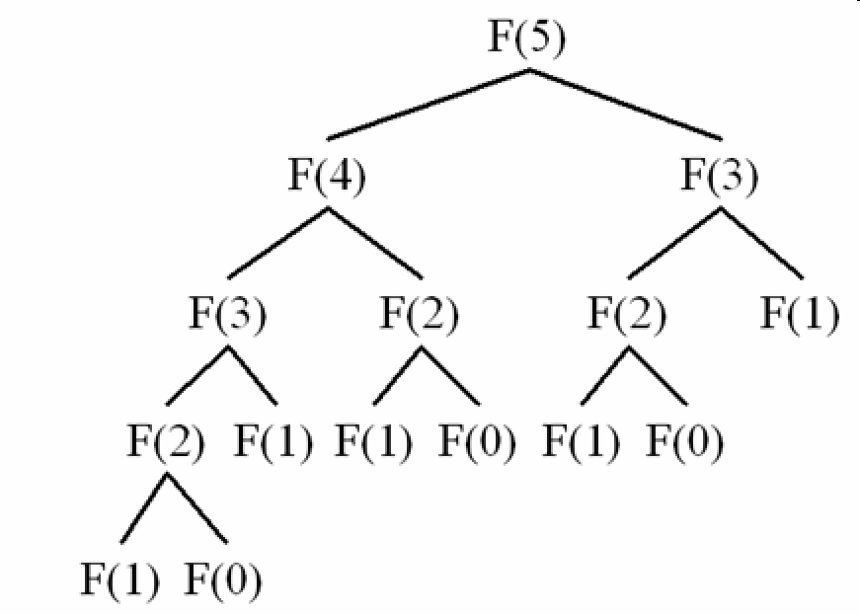
Fib(5)
Don’t compute anything more than once.
Alt. to solve using iteration → O(N)

Slide 58

Maximum Subsequent Sum Problem
Given integers A₁, A₂,…., A_{N}, find the maximum value of
ex: For input -2, 11, -4, 13,-5, -2
Maximum subsequence sum is 20 from
-2, 11, -4, 13,-5, -2
Four algorithmic solution with different running time : O(N³), O(N²), O(NlogN) and O(N)

Slide 59
Maximum Subsequence Sum
We will examine four algorithms to this problem.
Four algorithms with O(N³), O(N²), O(NlogN) and O(N) running times.

Slide 60
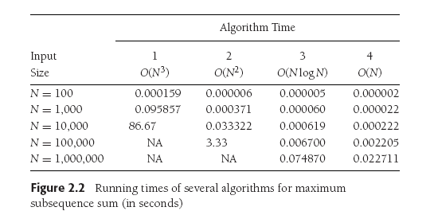

Slide 62
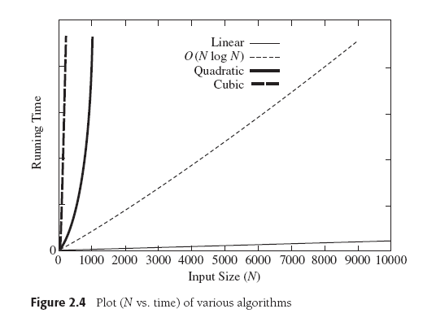

Slide 63
O(N³) Solution Analysis
Brute-Force Solution
Each for loop executes to maximum of N times
By rule of nested loops we multiple all the loop running times
Running time of the algorithm = O(N³)

Slide 64

Maximum Subsequence Sum Problem
N
N - i
j – i + 1
O(N³)

Slide 65







because sum i to j of 1 is j-i+1
$$\sum_{1}^{N}{i }$$
$$\frac{N(N+1)}{2}$$
=
because if j=i, then (i)-i+1 = 1
if j=i+1, then (i+1)-i+1=2
if j=i+2, then (i+2)-i+1=3
if j=N-1, then (N-1)-i+1=N-i
we see it is just summing the first N-i integers, so, use
$$\sum_{1}^{N}{i^{2} }$$
because, see page 40.
O(N³)

Slide 66
O(N²) Solution Analysis
Remove the unnecessary inner for-loop , which sums values from i to j.
Running time of the algorithm = O(N²)

Slide 67
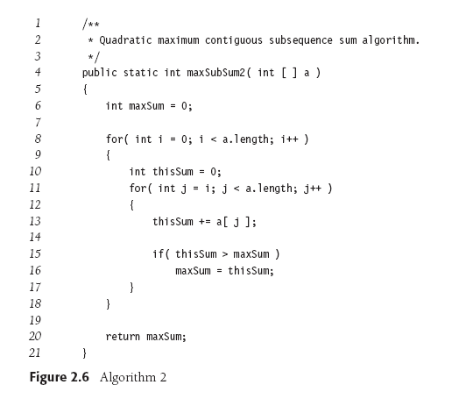
Maximum Subsequence Sum Problem
N
N - i
O(N²)

Slide 68
O(N²) Solution Analysis
What happens if the inner loop does not start from 0?
Dependent nested loops
sum = 0; for( i = 0; i < n; i++) for( j = i; j < n; j++)
sum++;
Here, the number of the times the inner loop is executed depends on the value of i:
i = 0, inner loop runs n times
i = 1, inner loop runs (n-1) times
i = 2, inner loop runs (n-2) times ...
i = n - 2, inner loop runs 2 times
i = n – 1,inner loop runs 1 (once)
Adding the right column, we get: ( 1 + 2 + … + n) = n*(n+1)/2 = O(n²)

Slide 69
O(NLogN) Recursive Solution
Split the list in half and use recursion
Find max sum of each half, left and right
Find max sum of that across the center
Then maximum sum of subsequence will be Max(left half, right half, across center)
This strategy is called “Divide and Conquer”

Slide 70
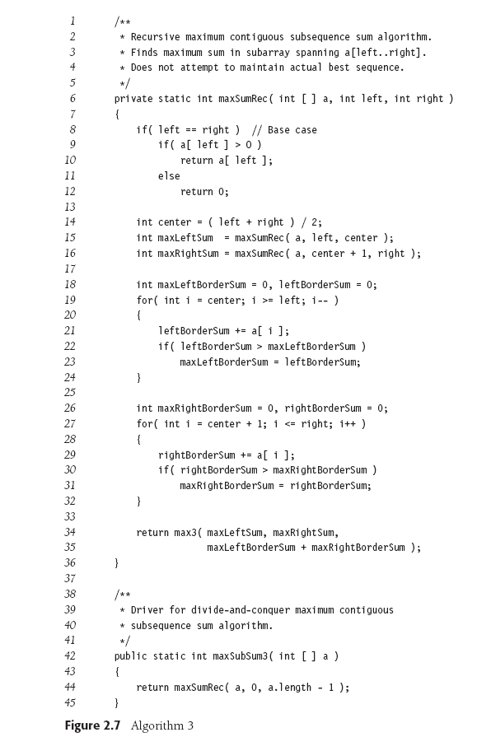
// Base Case = 1
// left half sum = T(n/2)
// right sum = T(n/2)
// compute half sum include last element of left half
Maximum sum that spans both halves
// compute sum include 1st element of right half

Slide 71
Example
4 -3 5 -2 -1 2 6 -2
Maximum Subsequent sum for first half = 6
Maximum Subsequent sum for second half = 8
Max sum in first half that includes the last element = 4
Max sum in second half that includes the first element = 7
Max sum across center will be sum of all values = 4+7 =11
Max sum of the sequence = max(6,8,(4+7))

Slide 72
O(NLogN) Solution Analysis
The two for loops take O(N) time
Let T(N) be time to solve the problem for N inputs
When N=1 T(N) = 1
Recursive call always divide the problem taking T(N/2) each
T(N) = 2 * T(N/2) + N

Slide 73
Recurrent Equation
T(N) = 2T(N/2) + N
T(1) = 1
T(2) = 2T(2/2) + 2 = 2T(1) + 2= 2*1 + 2 = 2 * 2 = 4
T(4) = 2T(2) + 4 = 2 * 4 + 4= 4 *3 = 12
T(8) = 2T(4) + 8 = 2 * 12 + 8 = 8 * 4 = 32
T(16) = 2T(8) + 16 = 2 * 32 + 16 = 16 * 5 = 80
= 16 * (log 16 + 1) = NlogN + N
Pattern is evident that for N= 2^{k}
T(N) = N*(k+1)
T(N) = Nlog(N+1) + N = O(NlogN)

Slide 74
Note to self
Show Recurrence relation two ways
In the book -> plug and check
Back substitution → working towards base case
Going from base case …. Till some value N=x … try to simply to identify pattern by writing in terms of k…
Visualize with Recurrence tree
Both: https://people.eecs.berkeley.edu/~vazirani/algorithms/chap2.pdf https://www.youtube.com/watch?v=MhT7XmxhaCE
http://fileadmin.cs.lth.se/cs/Personal/Rolf_Karlsson/lect1.pdf

Slide 75
-2,11,-4,13,-5,-2
max=20
-2,11,-4
13,-5,-2
max=11
max=13
-2,11
-4
13,-5
-2
max=11
max=13
-2
11
0
13
-5
0
0
11
13
0

Slide 76
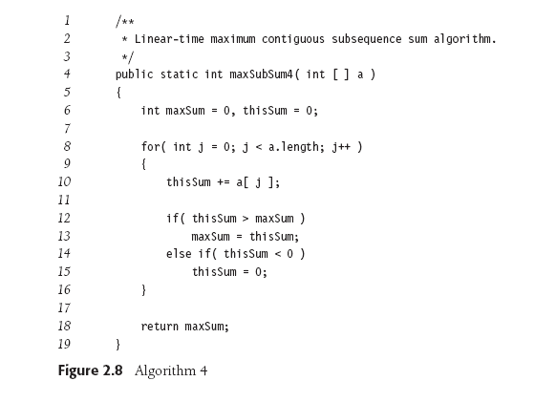
Maximum Subsequence Sum Problem
Sum becomes negative. restart
If as we advance j such that the subsequence sum from i to j turns negative, then we can advance the index value of i to j+1.
Starting a new sum whenever the current sum goes negative, and keeping the max sum as it moves.

Slide 77
O(N) Analysis
Running time is O(N)
This algorithm is called online algorithm:
Once data is read it does not need to be remembered
At any point in time, can correctly give an answer for the data it has already read

Slide 78
Logarithms in Running Time
Divide and conquer solutions often run in O(NlogN) time.
An algorithm is O(logN) if (repeatedly) it takes constant time to reduce the problem size by a fraction (eg. 1/2).
An algorithm is O(N) if (repeatedly) it takes constant time to reduce the problem size by a constant.

Slide 79
Logarithms in Running time
An algorithm is O(logN) if it takes constant time O(1) to cut the problem size by a fractions (usually ½)
Binary Search
Euclid’s Algorithm
Exponentiation.
To achieve O(logN), there should be preprocessing step performed on data.
Sorting

Slide 80
Binary Search
Preprocessing will be sorted list
NlogN amount of work
Given an integer X and integers A₀, A₁,… A_{N-1}, which is presorted find i such that A_{i} = X. or i= -1 if X is not found.
Check if X is the middle element if so, return i
else if X is smaller than the middle element , check X in the left half
else check if X is in the right half
A problem of size N can be split in half log N times
with constant time work at each split.
So this algorithm is O(log N).

Slide 82
Euclid’s Algorithm
For computing the greatest common divisor (gcd) of two values.
The gcd of two integer is the largest integer that divides both.
Example
gcd(50,15) = 5.
Observe 50%15 = 5. (Computing reminders until 0 is reached)
For example gcd (1989,1590) = 3

Slide 84
Analysis of Euclid’s algorithm:
After two iterations, the remainder is at most half of the original value. 2 log N = O(log N)
Proof: If M > N then M mod N < M/2
Consider two cases for N: N <= M/2 and N > M/2.
If N <= M/2, then M%N < M/2 (has to be because it is the remainder of dividing by N, and N is <= M/2, so the remainder must also be <= M/2).
If N > M/2, then M%N < M/2 (still has to be because it is the remainder).
So, the remainder is always < M/2.
It takes two iterations for this remainder to move into m.
Therefore, the running time is 2 log N, which is O(log N).

Slide 85
Exponentiation
Generally, to compute X^{N} we need N-1 multiplication
O(N) proportionally to number of multiplications
Recursive algorithm is used to reduce the running time to 2logN
Even N: X^{N} = X^{N/2} * X^{N/2}
Odd N: X^{N} = X^{(N-1)/2} * X^{(N-1)/2} * X

Slide 86
Exponentiation
Recursive algorithm is used to reduce the running time to 2logN
For example to calculate X⁶²
X⁶² = (X³¹ )²
X³¹ = (X¹⁵ )² X
X¹⁵ = (X⁷ )² X
X⁷ = (X³ )² X
X³ = (X² )X

Slide 88
Compute
2¹²
Even
2¹² normally takes 11 multiplies, but here it is done with just 4.
(2*2)⁶
Even
(4*4)³
Odd
(16*16) * 16
4096

